Slide 1
HYF .NET Masterclass 2022
Week 3

Slide 2
Agenda for today
Recap on Week #2 and homework
Revisiting some concepts and introducing a few new
A first MVC Application
Adding a model and controller action
A first Web API Application

Slide 3

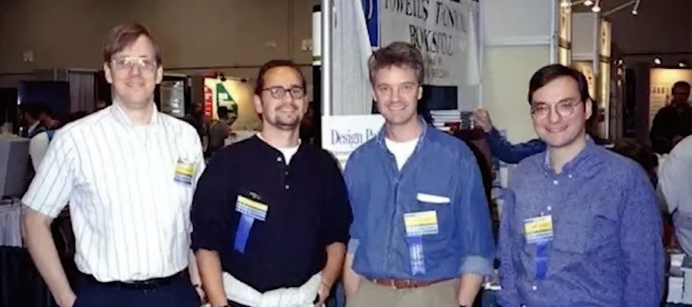
Design Pattern: MVC

Slide 4
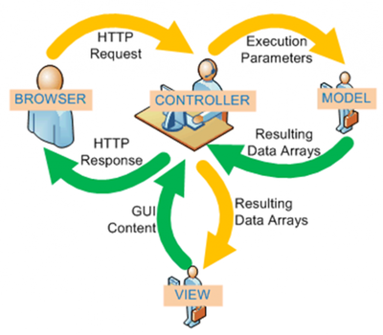
MVC – Model View Controller

Slide 5
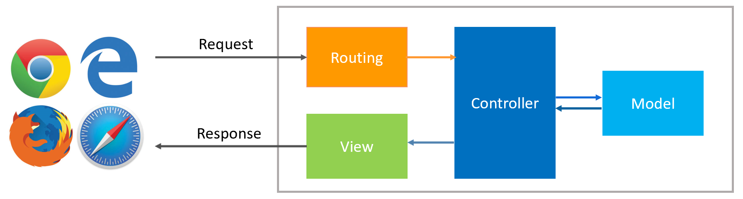
Routing
https://www.aspnethostingnews.com/asp-net-core-routing/

Slide 6
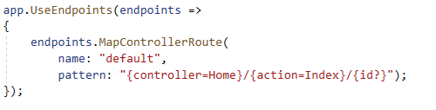
Routing configured in Startup class

Slide 7
Basic concepts: Namespaces
Putting code in a namespace is a way to group it.
Class names doesn’t have to be unique – namespace+name must.
Refer to classes using full namespace + name or with a using statement.

Slide 8
First MVC Application
dotnet new mvc

Slide 9
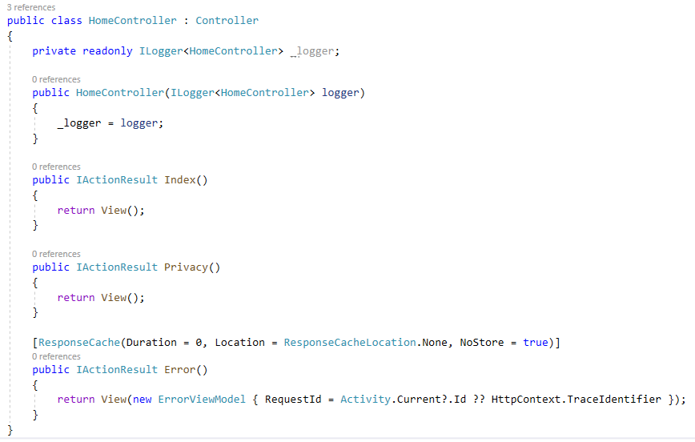
Controllers

Slide 10
Web API
dotnet new webapi

Slide 11
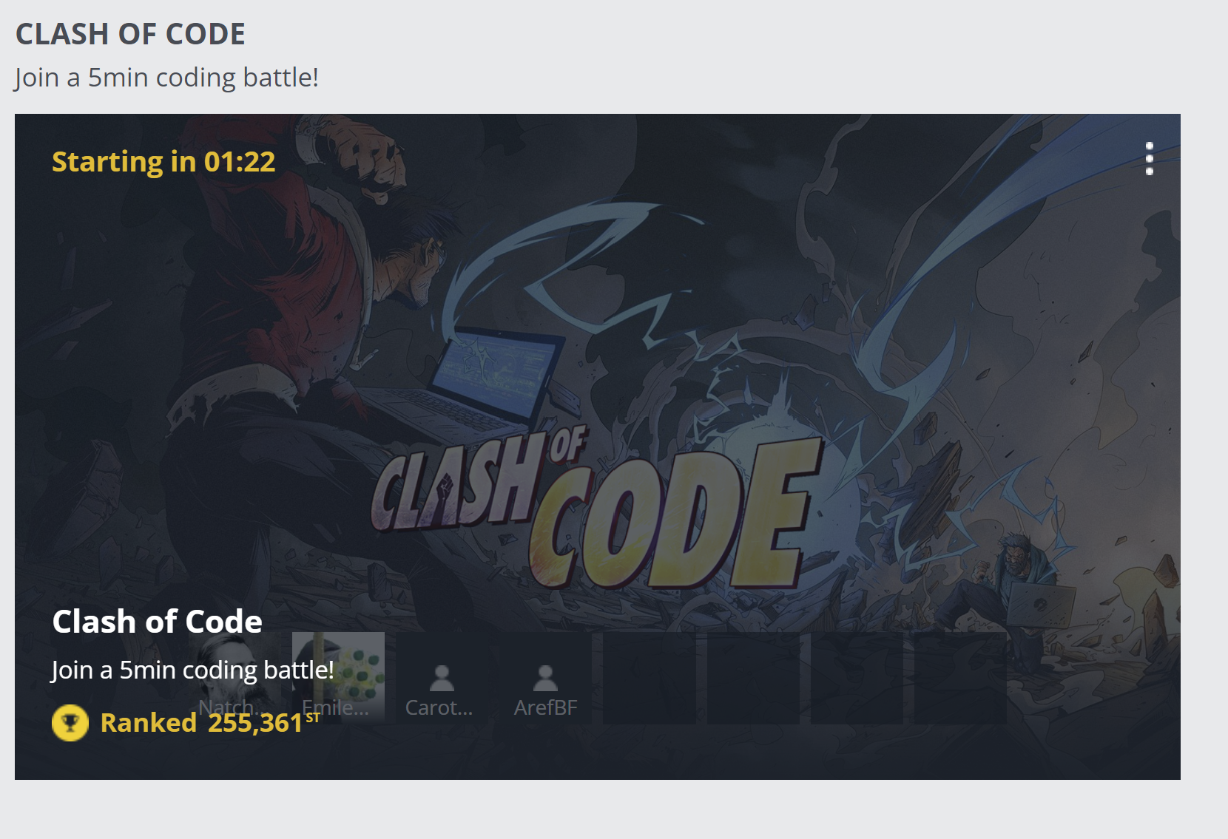
Codingame.com

